Slide 1
Neighborhood Matching Grants
Pre-application workshop, part 2 of 3
Application Overview: Tips for submitting a competitive application
Notes:
Welcome to the Neighborhood Matching Grants pre-application workshop.

Slide 2
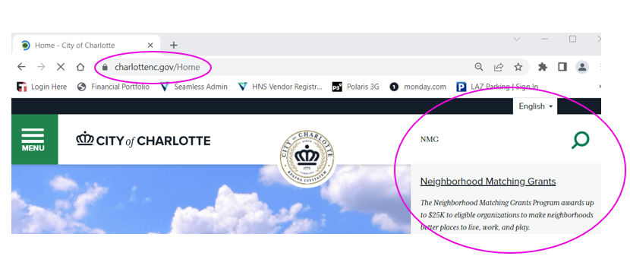
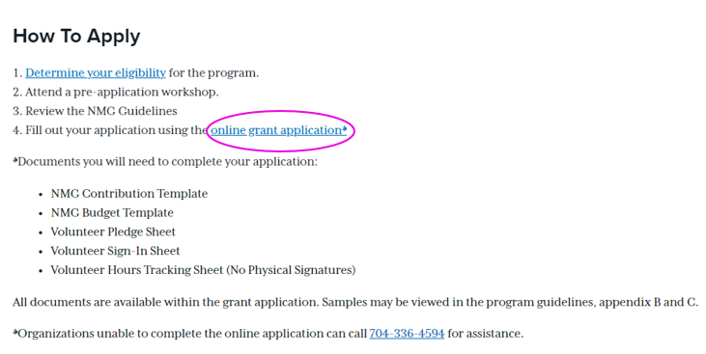
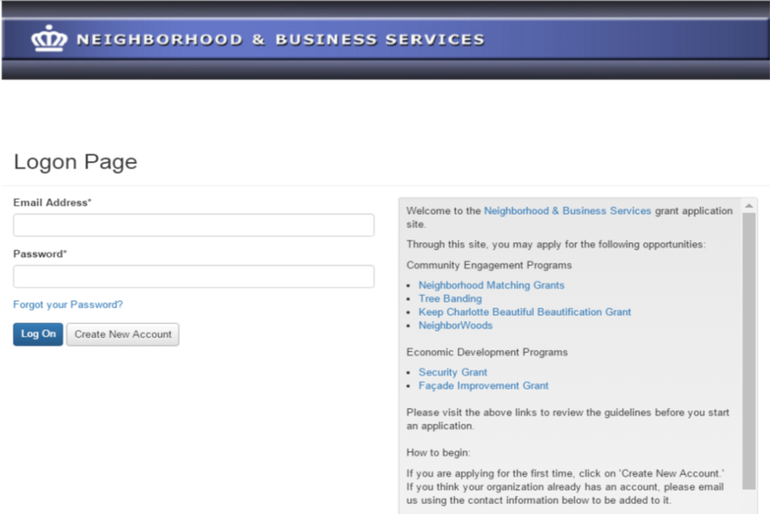
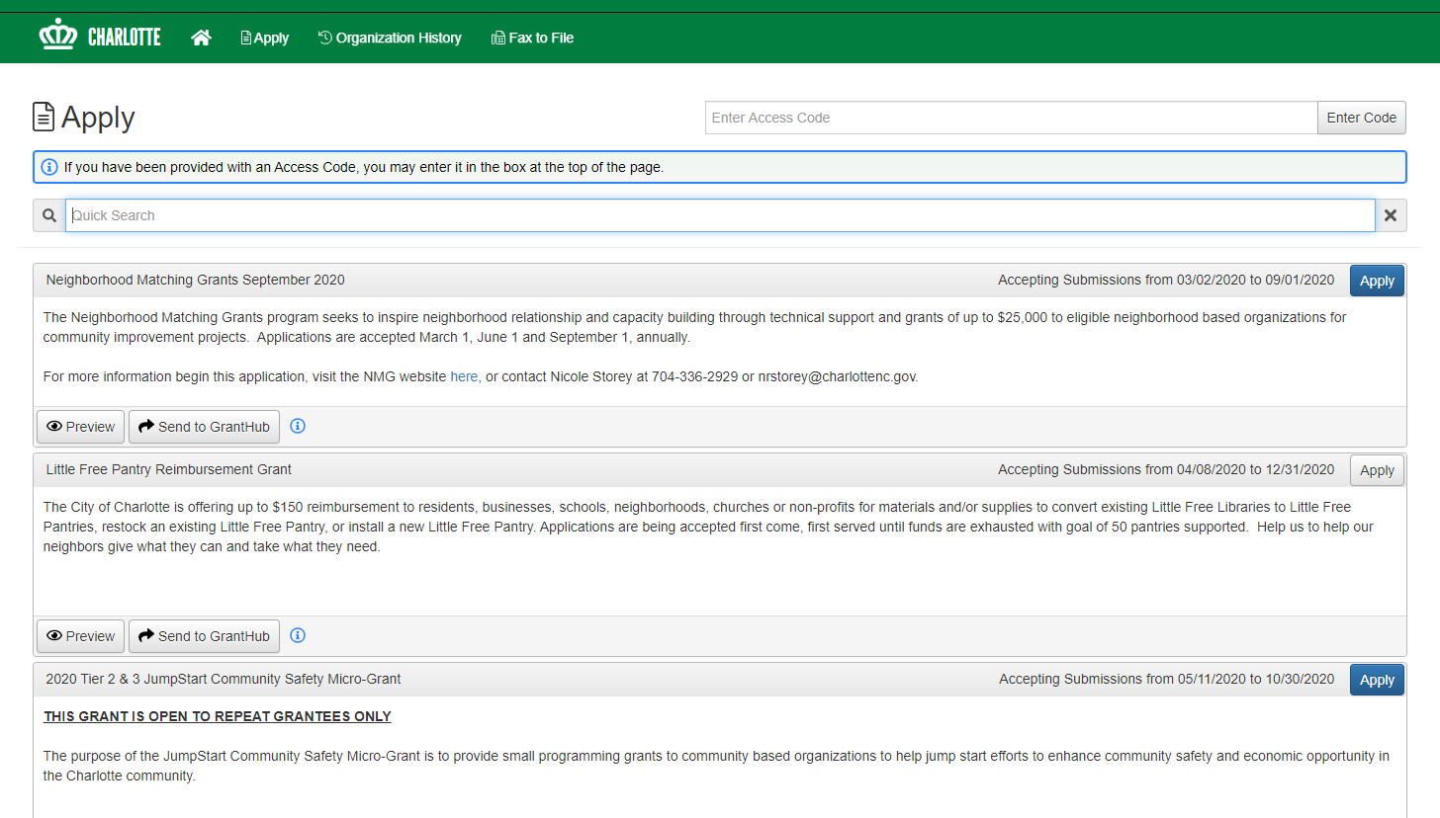
Online Application
https://www.charlottenc.gov/Streets-and-Neighborhoods/Get-Involved/Neighborhood-Matching-Grants
awesomeperson@home.com
Showmethemoney**
“Apply” page shows all
open grant opportunities
Notes:
Once you have your project and engagement activities planned out, it’s time to start the application!
The link to the website is shown at the top right but the easiest way to get to it is simply to go to Charlotte N.C. dot G.O.V. and type NMG in the search bar
Scroll until you see the link for the online grant application. This takes you to the login page – here you will create new account, or login if you already have credentials. If your organization has applied in the past and you need an account, please let us know. It is not necessary to create a new record for your organization.
Click on Apply and select the current NMG application.

Slide 3
Online Application
Project Details
Project name & overview
Organization details
Project details
Neighborhood participation
Project evaluation
Sustainability
Marketing & promotions
Required worksheets
Budget & volunteer pledges
Supporting info
Before photos
Cost estimates
Owner Permission
Design sketches, location list
Etc.
Invite others to work with you on the application using Collaborate
Notes:
On the right is a screenshot of the online application.
The bulk of the online application asks you to describe your project in detail.
A thorough application helps us understand your vision, the support of your community, and how the proposed project will improve your neighborhood.
While we encourage neighborhoods to decide upon their own projects, we are happy to help you think through the details.

Slide 4
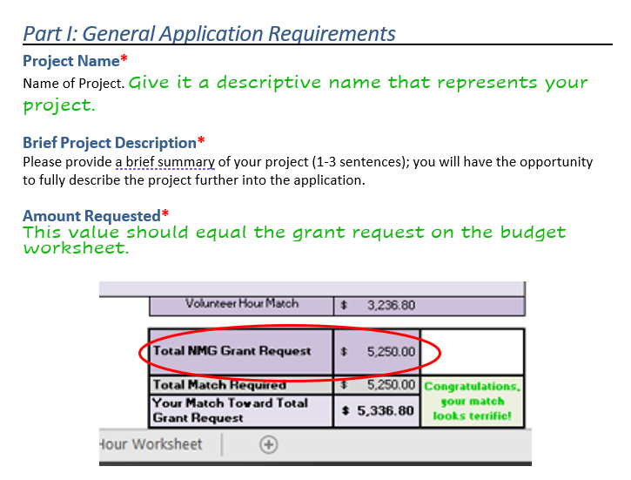
Notes:
Our goal is to help you fill out a complete and competitive application! This presentation covers select the questions. The questions that aren’t discussed are also important, so make sure to read each one thoroughly and answer the question that is asked.
We’ll start with the easy stuff! Give your project a name – and make it descriptive. You want your application to stand out in the reviewers’ minds.
As an example, Signage Project is better than June Matching Grant
In the next question, you’ll summarize your project in a few sentences.
Be specific and succinct: Install 1 brick monument sign and 10 sign toppers on Trade Street is better than Install signs in the neighborhood. Again, being descriptive helps the reviewers distinguish your project from all the other applications.
Leave the amount requested blank until you’ve finalized your budget. The value should equal the grant request on your budget worksheet.

Slide 5
The code for 2024 online workshop attendance is: OL2024
If you attended a live or scheduled Zoom workshop, enter that date.
Notes:
The code for 2024 online workshop attendance is: OL2024 (that’s letter O, letter L, numbers 2 0 2 4)

Slide 6
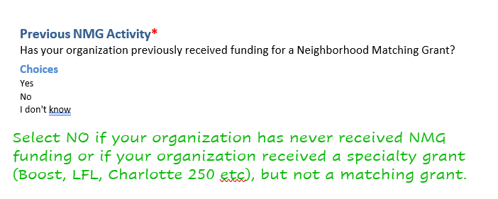
Notes:
This question about previous activity is designed to help simply the application if you’ve received funding previously. If you aren’t sure, select No.
We need your neighborhood boundaries – we’ve provided names of a few map programs that you may find helpful. There’s another question in the project details section that asks you to show where your project is located -- you can use these same tools for that question.

Slide 7
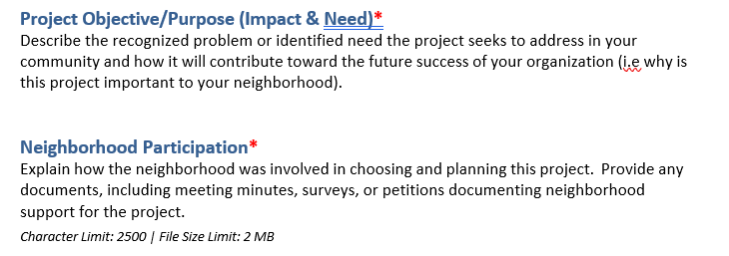
Notes:
Part 3 of the application focuses on your Project Objective:
Start by defining the problem or issue you want to address…. Think about how your project will create or increase [something positive] or eliminate or decrease [something negative] AND say why or how that will benefit your neighborhood.
Example of a real project -
Background: HOA community is requesting funding for a new fence around their pool. They had an existing fence, but discovered that it was too easy to climb. Teenagers and young adults from other communities would drive up at night, climb the fence and use the pool – they also climbed up and jumped off the roof of the pool house.
The organization was able to define the problem: inadequate fence was leading to liability issues, including potential for injury or death, possible damage to the roof of the pool house, safety and security of the residents – the kids were usually rowdy and rude, the neighbors have to call the police to get them to leave.
In their application, the organization was able to show why the grant was important to the community: a new taller, hard to climb fence would lessen chance of someone getting seriously injured and suing the community, prevent damage to their property and provide peace of mind to the residents.
The NMG is meant to be a group activity so you’ll need to show Neighborhood Participation –The next question has space for written narrative to describe how your neighbors were involved in choosing the project.
Be specific in your description: At the meeting on DATE, our community discussed 3 projects and voted on x. “ or We conducted a survey on x date and the project with the most votes was X.
Back up your narrative with documentation… Provide meeting minutes, copy of survey and the results, or other documents that show you came together as a group and chose the project together.
If only your board has discussed the project, get a community meeting on the books or send out a survey ASAP so you can show that the project was communicated and the whole community had a chance to provide input and agree upon the project.
External Collaboration
If you are working or partnering with another organization to implement your project, describe it in detail. Who is the partner, what is their role. How will their participation impact your project? External collaboration is not required but does strengthen your application.

Slide 8
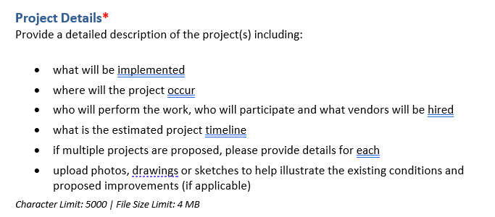
Notes:
Project Design and Details should cover most of these these bullet points in detail, including providing an estimated timeline
-- if doing multiple projects, each project should be clearly described and have a timeline
**Provide photos of the existing conditions when possible:
For example: If the project is to convert an empty lot to a soccer field, take photos of the existing space and provide sketch of what it will look like when complete, include photos of the nets and equipment you want to purchase.
You are trying to illustrate to the review team how your project is an improvement for your community. For physical projects, before photos are key!

Slide 9
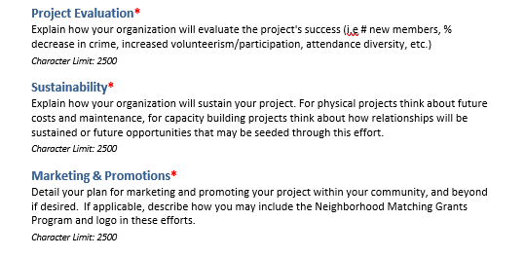
Notes:
The review team is also interested in how you will evaluate the success of the project
Success will look different for every project – define what it looks like for your project.
Be specific, have a baseline – know what your starting point is so you know if the project is successful.
A good answer is specific –”attendance will increase by 10% by end of year” is much better than “attendance will increase” – make sure your answer is realistic and attainable – 10% vs 50%
For physical projects, explain how you will sustain the effort once grant funding has ended. If your application is for a landscaping project and you’ll be hiring a company to do the work, will they provide ongoing care – how much will that cost, how will you pay for it? Dues, donations, etc
Lastly, you should explain how you will market and promote your project to those in your neighborhood. Will you send out fliers? Use social media? Go door to door?
Thinking through these details during the application process will help things run smoothly once the project is underway.

Slide 10
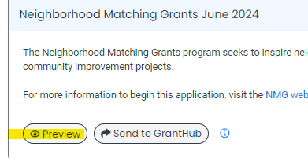
Notes:
When you click to application apply button, you’ll be able to preview the application and download the question list.

Slide 11
Scoring Criteria | Max Points
Size and quality of match Match meets the minimum required (5 points) Proposed match is well documented and ready to expend (5) | 10
Participation and Collaboration Planning & implementation show evidence of broad-based neighborhood participation (15) Project includes external collaboration(s), outside of neighborhood residents (5) | 20
Project Impact/Need Provides a substantial and lasting neighborhood benefit (15) Addresses a recognized problem or identified need (15) Project is located in a priority area (5) | 35
Project Design Well-planned and ready for implementation (15) Budget is realistic and clearly described (10) Includes a clear plan for marketing, promotion and community outreach (10) | 35
Total Possible Points | 100
Notes:
At this point, you’re probably curious about how applications are reviewed and scored.
Neighborhood Matching Grants applications are reviewed in a two-phase process that takes 8-10 weeks from the application submission date. Once you have submitted your application, you will be assigned a staff liaison who will review your application and may reach out to clarify questions.
This first phase also includes time for other staff members to review your application should your project need permission from CDOT or other departments. We do not make decisions or have influence over the requirements or processes of other departments, but we work together to try to move your project forward.
**Important Change*** (effective June 1, 2024 grant cycle)
The 3-week clarification period has been replaced with additional support up front to help you submit a competitive application. Each application cycle will include several drop-in sessions where you can ask questions, or ask us to review your application before submission. Again: our goal is to help you submit a complete and compelling application, not to ask you for major edits and clarifications after submission.
Once your project is approved to move forward, our board members meet to review and vote on grant applications. One review team considers requests of $10,000 and less, and a second review team considers requests from $10,001 to $25,000. Applicants are encouraged to attend review team meetings in order to advocate on behalf of their projects.
The review teams use the criteria you see on your screen to score your applications. They are making sure you have a plan to match the grant 100% and have met the minimum requirement of half of that coming from volunteer engagement activities. They also are looking at evidence of neighborhood participation, the impact the project will have on your neighborhood, and how well planned your project is.
Each application question has prompts to assist you in answering the questions to help you get the best score…be sure you read and answer each question thoroughly. Reach out to our team with questions!

Slide 12
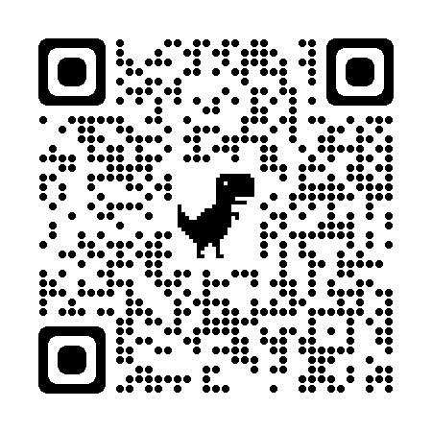
More Information
NMG Website
https://www.charlottenc.gov/Streets-and-Neighborhoods/Get-Involved/Neighborhood-Matching-Grants
Sign-In Sheets, Current Guidelines and Other Documents https://publicinput.com/nmgforms
Questions:
Jackie Clare Community Grants Program Manager | Maddi Meade Watson Neighborhood Programs Support Specialist
jackie.clare@charlottenc.gov 980-214-3540 | madison.meade@charlottenc.gov 980-416-7035
Notes:
Here are ways to get more information and contact info for program staff.
Thanks for participating in this virtual workshop!

