Slide 1
Neighborhood Matching Grants
Pre-application workshop, part 1 of 3
Overview of Eligibility and Program Requirements
Notes:
Welcome to the Neighborhood Matching Grants pre-application workshop.

Slide 2
Agenda
Overview of eligibility and requirements
Tips for submitting a competitive grant application
Required documentation and other resources
Notes:
This workshop will be split into 3 parts:
Overview of eligibility and program requirements
Tips for submitting a competitive grant application
And review and tips for completing the budget worksheet and other required documentation, along with other ideas and resources.

Slide 3
NMG Program Goals
Engage residents
Create partnerships
Revitalize and reinvest in neighborhoods, providing the greatest resources in the areas of greatest need
Support the success of all neighborhoods to self-determine and complete improvement priorities
Notes:
The goals of the Neighborhood Matching Grants program are to:
Engage residents
Create partnerships
Revitalize and reinvest in neighborhoods, providing the greatest resources in the areas of greatest need
Support the success of all neighborhoods to self-determine and complete improvement priorities

Slide 4
NMG: The Basics
Created in 1993, managed by Housing & Neighborhood Services
Up to one year of funding, $10k-$25k max
Requires 1:1 Match
Reimbursement Grant – funds not paid in advance; organizations submit receipts for reimbursement.
Currently open NMG grants must be closed prior to submitting new application (KCB and/or placemaking grants can be open simultaneously.)
Application is due by 11:59 PM on June 1, 2024
Notes:
Next, let’s review the basics!
The Neighborhood Matching Grants (NMG) program was created in 1993, and is managed by Housing & Neighborhood Services
Applicants may apply for up to one year of funding, the maximum awards are $10k or $25k, depending on an organization’s eligibility level.
The NMG program requires that all funds awarded by the city are matched by the organization. Most organizations meet the match by pledging volunteer engagement hours. No cash is required to participate in the NMG program.
This is a Reimbursement Grant – that means that funds are not awarded in advance, but paid on an as needed basis upon the organization’s submission of receipts or invoices for reimbursement.
Currently open Neighborhood Matching grants must be closed prior to submitting new application.

Slide 5
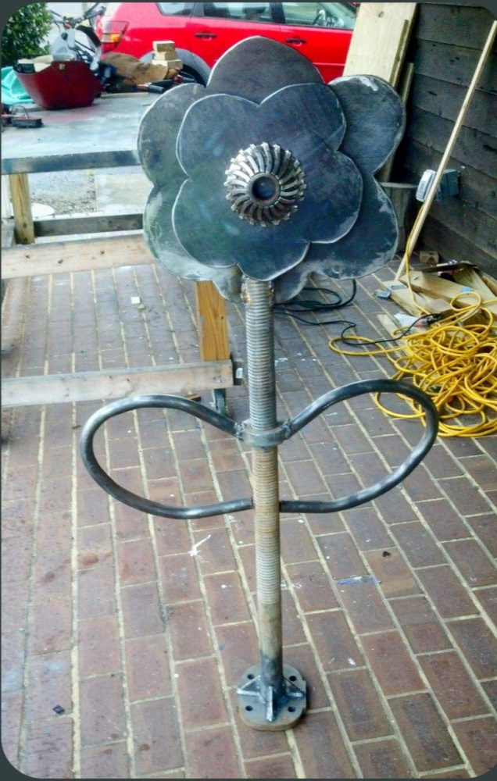
Who Can Apply?
NMG Eligibility is determined by two considerations:
1. Geographic Eligibility
Based on n’hood Median Property Value (MPV)
2. Organizational Eligibility*
The following types of organizations may apply:
Neighborhood Associations/Coalitions
Homeowners Associations (HOAs)
Resident Organizations in Rental Communities
Criteria for all Organization Types
≥ 25 homes or units represented
Established and active for at least 6 months
Membership Open to all neighborhood residents, including renters
Has duly elected board & at least one of the following governing documents: Articles of Incorporation, Bylaws, Declaration of Covenants, Conditions & Restrictions (CC&Rs.)
See Program guidelines for details.
Plaza Midwood Bike Corral
Notes:
Like most grant programs, we have eligibility requirements. Before applying for a grant, it’s important to ensure that your organization is eligible.
Eligibility is based on two criteria: Geographic eligibility, which we’ll discuss in the next slide and organizational eligibly.
The Neighborhood Matching Grants program only awards funds to neighborhood-based organizations. This typically includes neighborhood associations or coalitions, HOAs, and resident organizations in rental communities.
However, we do recognize that many organizations such as business associations, churches, and schools do not meet our eligibility requirement. These groups are encouraged to partner with eligible organizations to support projects that contribute toward accomplishing shared goals.
All organizations must meet the following criteria:
Represent at least 25 homes or units
Be established and active for at least 6 months prior to applying for a grant
Has a membership that is open to all neighborhood residents , and
Has a duly elected board of directors and at least one of the governing documents on the list above
Organization definitions and other details can be found in the program guidelines on our website

Slide 6
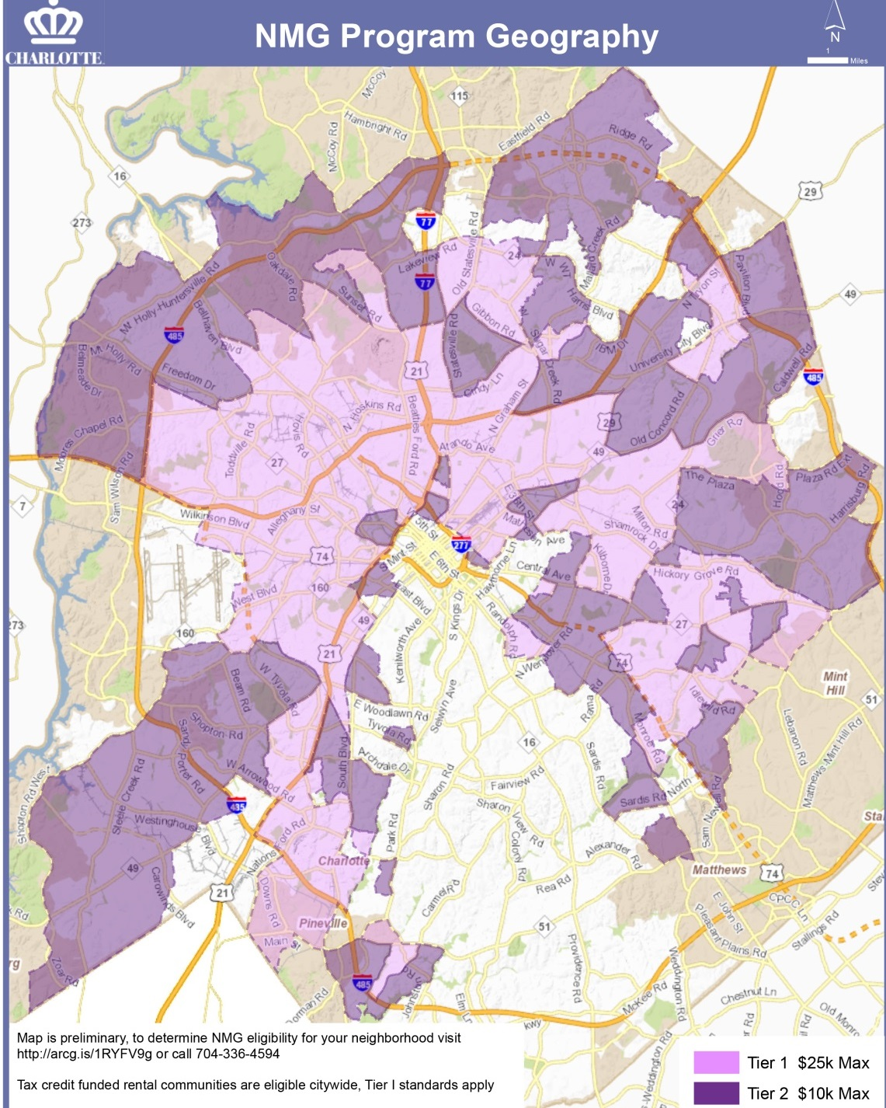
Geographic Eligibility*
Eligibility Tier | Tier I* | Tier II*
NPA Median Assessed Property Value | < $104,110 | $104,111 to $181,703
Maximum Grant Award -Neighborhood Associations & HOA’s -Rental Communities (Tier I applies to Tax Credit Funded Communities) -Neighborhood Coalitions | Up to $25,000/ application, no per year maximum Up to $25,000/ application, $25,000 max per fiscal year | Up to $10,000/ application, no per year maximum Up to $10,000/ application, $25,000 max per fiscal year
Project Restrictions | None | Exterior Curb Appeal & Existing Community Property Improvements ineligible
2023 Meck County revaluation changes coming, Effective March 1, 2025
Notes:
In addition to an organizational requirement, we also have a geographic requirement.
In the map on your left, areas that are shaded purple/pink are eligible for the Neighborhood Matching Grants program.
The median assessed property value determines the neighborhood’s tier of eligibility, which affects the maximum grant award. Eligible organizations can apply for more than one grant each year, but only one neighborhood matching grant can be open at a time.
Neighborhoods with a median assessed property value equal to or less than $181,703 are eligible. These values are based on the property valuations prior to the 2019 revaluation. Roughly two-thirds of neighborhoods within Charlotte meet this geographic requirement. The eligibility values based on the Mecklenburg County 2023 property revaluation will go into affect for the March 1, 2025 NMG application cycle. Look for more information early next year.
If you are unsure of your eligibility level, go to the “who can apply” page on the website and click the link for eligible geography to type in your address.

Slide 7
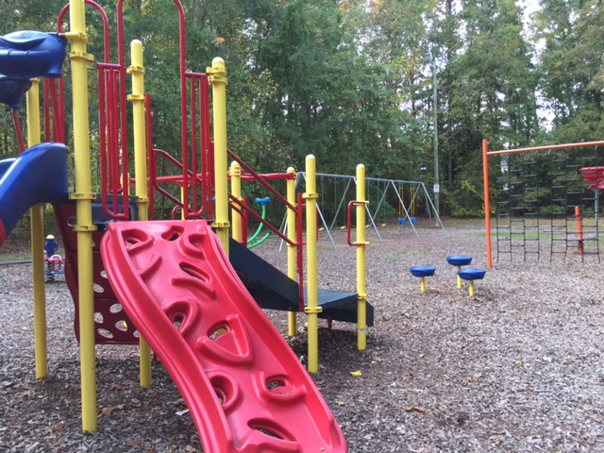
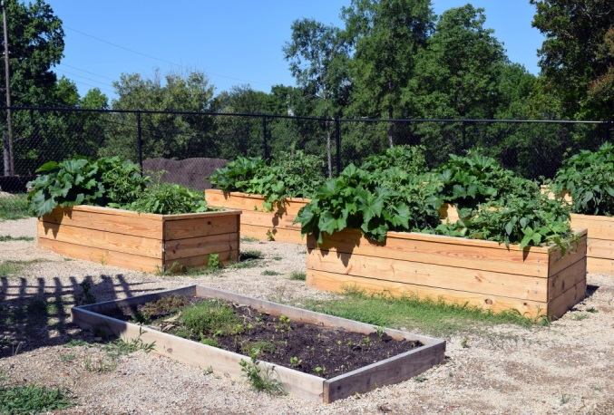
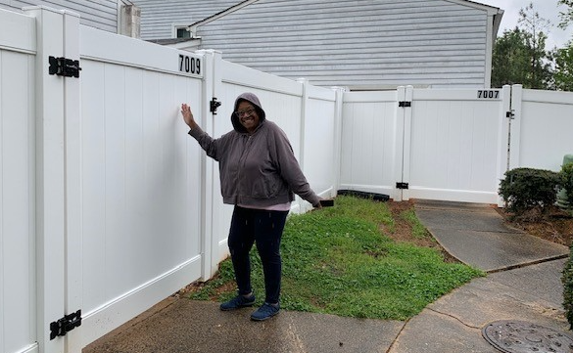
What can you do?
All NMG Projects must:
Provide a shared neighborhood benefit that remains accessible to all residents
Engage residents in selection, planning & implementation
Not duplicate existing programs or fund existing projects
Meet applicable requirements, see Program Guidelines, Appendix A
Notes:
Determining your project – what can you do?
Neighborhood matching grant projects are meant to be fun, and we encourage your neighborhood to be creative! There are many examples of projects on our website, but you do not need to apply for something that has already been done.
Feel free to apply for projects that we have not funded in the past.
There are some broad requirements for projects, including that projects must provide a public benefit to everyone in the neighborhood.
-This means that it should be something that all the neighborhood residents can be proud of and benefit from, not just the members of the board or residents on one particular street.
-Additionally, the project should involve project activities and implementation steps, and it should engage residents in the planning and implementation.
Through the NMG Program, we want to encourage neighbors to build relationships with one another. This can't happen if people are just buying a bunch of stuff and it’s the reason we place so much emphasis on working together throughout the entire application and project implementation process!

Slide 8
Ineligible Expenses
The following are ineligible for grant funding, but may be included as cash/inkind donations toward the required match:
Food & Beverages
Entertainment- DJ, Clown, band
Operating expenses – maintenance, rent, utilities, etc.
Salaries
Annual plants (perennials are ok)
Entrance fees
Raffles/giveaways
Gift cards
Pine needles/mulch (rubber mulch & mats are okay)
Notes:
Not all costs associated with your project are able to be reimbursed. The items on this list may be included in your project as cash or inkind gifts, but are not eligible for project funding.

Slide 9
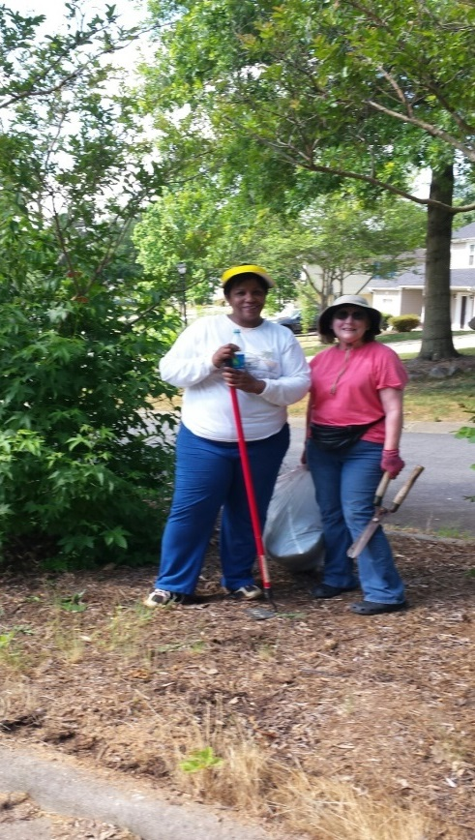
Match Requirements
1:1 Match Required
50% must be met through Volunteer Engagement Activities 1 Hour of Activity = $33.49. Activities may begin after grants are approved Can be 100% volunteer engagement hours (no cash req’d)
100% volunteer hours = 746.50 @ $25k, 298.50 @ $10k over 1 year
May include 20hrs documented pre-application work
Board Retreat Credit toward volunteer hour requirement*
Credits are applied to the second half of the match requirement – 50% hours must be met first.
Other Match Types:
Cash contributions: money from board, individuals or sponsors
In-kind donations: donated or discounted services, meeting space, refreshments, Neighborhood Board Retreat credits
At least 25% of total match must originate from neighborhood residents or members
Forest Pawtuckett Clean Up
*Board Retreat Credit beginning March 2024 is $2000. Unexpired credits earned prior to that date are valued at $1500.
Notes:
To elaborate on the earlier slide: 100% of city funds awarded must be matched by your organization.
This can be done entirely though volunteer engagement activities or a combination of activities, cash and inkind donations. You may also count up to 20 hours of work you and your neighbors have done preparing for your grant application. Meetings you held, pledge drives and other events where you came together as a group to discuss the project may be included.
If you have a board retreat credit, that credit will be applied after the 50% minimum volunteer hour requirement is met. You’ll note this on the second tab of the budget worksheet.

Slide 10
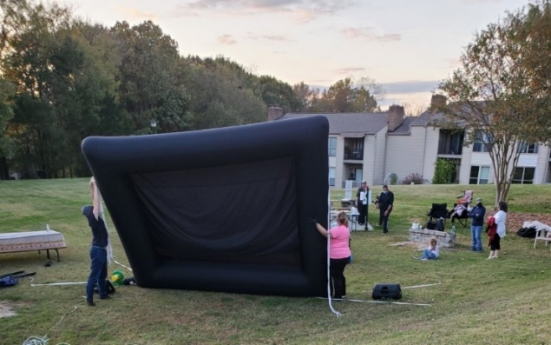
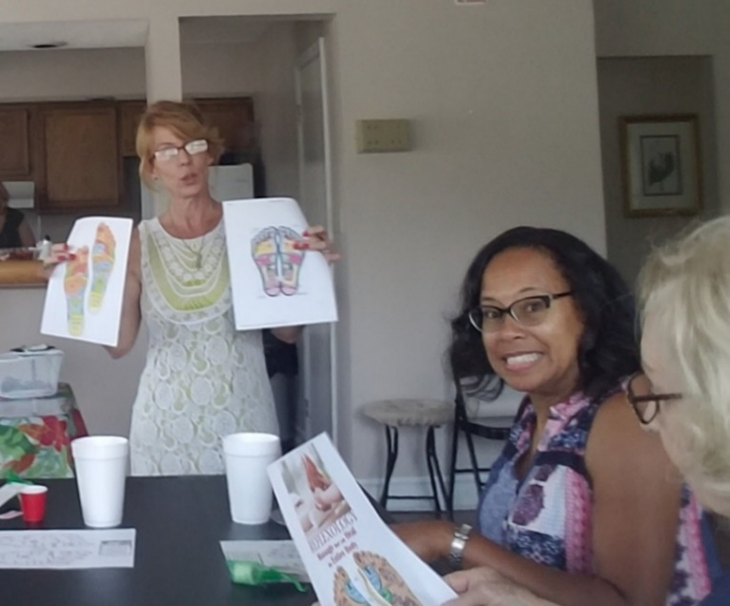
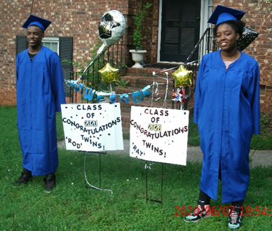
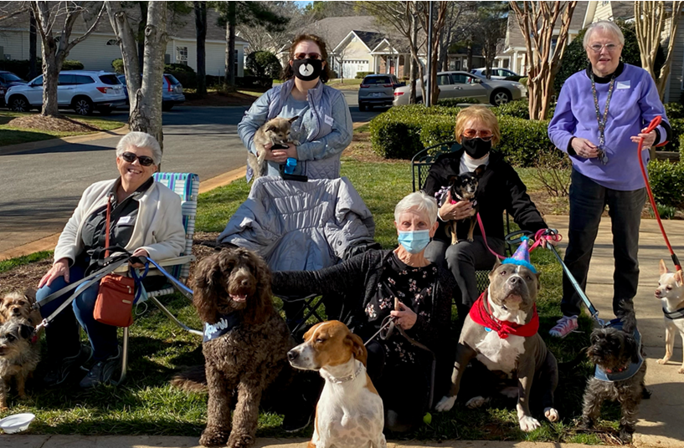
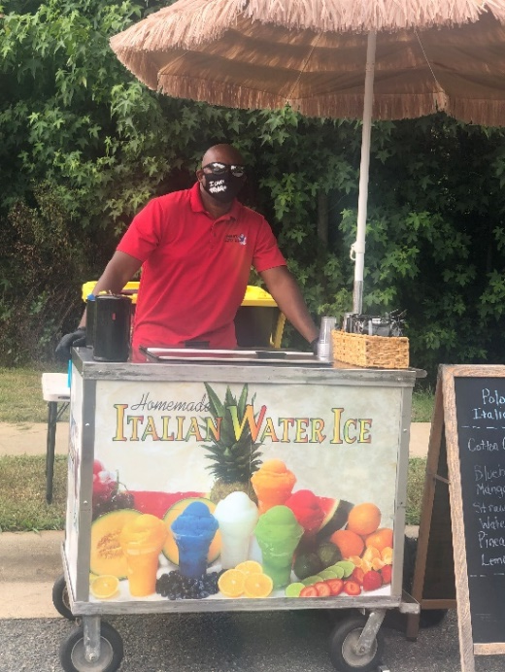
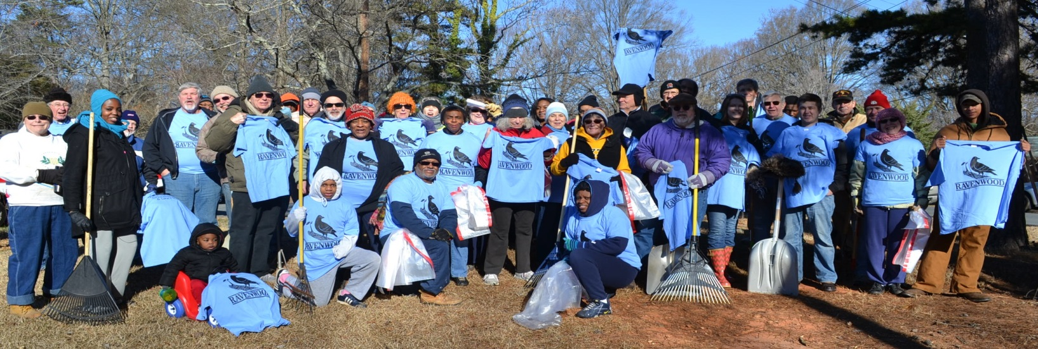
Volunteer Engagement Ideas to Meet the Match Requirement
Outdoor Movie Night Carmel Village
Social Activities with Pets Huntington Ridge
Graduation Celebration Shannon Park
Reflexology Workshop Becton Park
Other Match Suggestions- street adoption, project planning & update meetings, site preparation, youth participation, groundbreaking/ribbon cutting celebrations, get to know your neighbor events, project installation, communications and more!
Food Vendors Belmar Place
Community Clean Up Ravenwood Neighborhood
Notes:
Again, Volunteer engagement hours must account for at least 50% of the match. Volunteer hours can be for any activities that help build community. Volunteer hours should include project installation whenever possible. Many neighborhoods also do community clean-ups, but engagement activities DO NOT have to be all work!
Neighborhoods have hired food trucks, showed movies in the park, organized Bingo and trivia contests, taken classes together, and many other fun activities. All that we require of you is to create opportunities for neighbors to come together to work, play or learn – with goal of getting to know each other better and strengthening your community!
**If your organization has received a grant in the last 3 years, you know that during the pandemic, we provided opportunities for socially-distant and solo volunteer activities. Now that most groups have resumed face to face activities, those opportunities are no longer available. Your volunteer activities should be planned for groups of 5 or more adults***
Remember, wait for your grant to be approved before starting your activities.

Slide 11
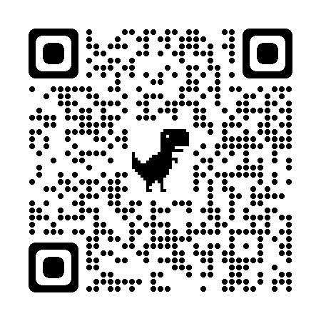
More Information
NMG Website
https://www.charlottenc.gov/Streets-and-Neighborhoods/Get-Involved/Neighborhood-Matching-Grants
Sign-In Sheets, Current Guidelines and Other Documents https://publicinput.com/nmgforms
Questions:
Jackie Clare Community Grants Program Manager | Maddi Meade Watson Neighborhood Programs Support Specialist
jackie.clare@charlottenc.gov 980-214-3540 | madison.meade@charlottenc.gov 980-416-7035
Notes:
Here are ways to get more information and contact info for program staff.
Thanks for participating in this virtual workshop!

